Slide 1
IMMUNODEFICIENCY DISEASES Dr. KADUYU DENNIS
INTRODUCTION
CLASSIFICATIONS
HIV AND AIDS

Slide 2
DEFINITION
Immunodeficiency diseases are diseases that arise due to inability to produce adequate immune response because of an insufficiency ,absence of antibody ,immune cells or both.
CLASSIFIACTIONS
Primary/congenital immunodeficiencies are usually the result of genetic or developmental abnormality of the immune system.
Examples
Hypoplasia of thymus
Combined humoral and cell mediated defects
Agammaglobulinaemia due to defect of pre-B cells to differentiate to mature B cells

Slide 3
Secondary immunodeficiencies
These arise from acquired suppression of the immune system.
There are many causes
Malnutrition
Cancer
Bone marrow diseases e.g bone marrow aplasia
Patients on immunosuppressive therapy e.g preventing graft rejection
Infections e.g. HIV
NOTE
The most common secondary immunodifiency disease is AIDS

Slide 4
ACQUIRED IMMUNODEFIENCY SYNDROME
DEFINITION
EPIDEMIOLOGY
ETIOLOGY
RISK GROUPS
MODE OF TRANSMISSION
PATHOGENESIS
AIDS

Slide 5
DEFINITION
Is a disease caused by the retrovirus human immunodeficiency virus (HIV) characterized by profound immunosuppression that lead to opportunistic infections, secondary neoplasm and neurologic manifestation.
EPIDEMIOLOGY
Although initially recognized in United States .AIDS is now a global problem .
It has now been recognized in more 190 countries .The pool of HIV infected persons in Africa and Asia is large and expanding.
Because of public health measures the infection rate seems to be decreasing ,furthermore improved Antiviral therapies have resulted in fewer people dying of the disease. ,however the newer treatments are not readily available in many developing countries and side effects remains a problem.
The manufacturing of these drugs raises its own tragic concern because more people are living with HIV hence the risk of spreading the infection will increase if vigilance is relaxed.

Slide 6
ETIOLOGY
AIDS is caused by an RNA retrovirus called human immunodeficiency virus (HIV) belonging to the Lentivirus family.
Two genetically different but related forms of HIV called HIV-1 and HIV-2 have been isolated from patients
HIV-1 common type with AIDS in United States ,Europe and Central Africa
HIV -2 IS common in West Africa .
RISK GROUP
Soldiers
Multiple sexual partners
Men who are uncircumcised
Truck drivers
Sex workers
Fish mongers
Homosexuals

Slide 7
MODE OF TRANSMISSION
The 3 major routes of transmission are
Sexual Contact
75% of all world wide transmission is heterosexual transmission.
Parenteral transmission
In intravenous drug abusers ,hemophiliacs and random recipient's of blood transmission .
Mother to child transmission
About 25% -30% HIV ,positive mothers will transmit HIV to their infants.
About 60% of this infection will is transmitted during child birth
About 25% during pregnancy
About 15% during breast feeding
Need prick
Accidental needle prick or exposure to non-intact skin to infected blood accounts for about 0.3% of infections.

Slide 8
HIV Structure and Function
The mature virus consists of
A core containing the viral genome.
Two short strands of ribonucleic acid (RNA).
The enzymes reverse transcriptase, protease, ribonuclease, and integrase.
An outer lipid envelope with 72 surface projections containing an antigen, gp120, that aids in the binding of the virus to the target cells with CD4 receptors.

Slide 9
HIV Structure and Function
ENV gene codes envelope glycoproteins, including the outer envelope glycoprotein gp120 and transmembrane glycoprotein gp41 derived from glycoprotein precursor gp160.
GAG gene codes core nucleocapsid proteins p55, p40, p24 (capsid, or "core" antigen), p17 (matrix), and p7 (nucleocapsid);
POL gene codes the enzyme proteins p66 and p51 (reverse transcriptase), p11 (protease), and p32 (integrase).

Slide 10
HIV Structure and Function
HIV has the additional ability to mutate easily.
This high mutation rate leads to the emergence of HIV variants within the infected person's cells that can resist immune attack, are more cytotoxic, or can resist drug therapy. Over time, different tissues of the body may harbor differing HIV variants.

Slide 11
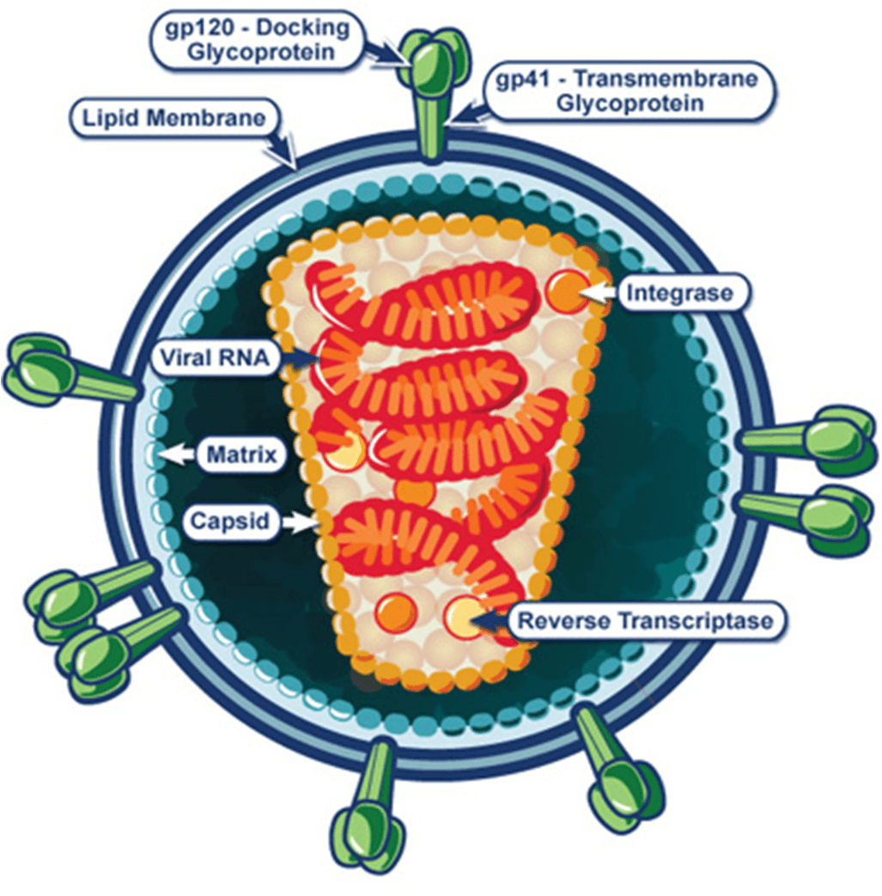

Slide 12
CELLS HAVING CD4 RECEPTOR
CD4+ T-helper cells
Monocytes /macrophages
Tissue cells such as dendritic cells present in genital tracts and anorectal region
Certain brain cells (glial)
And some other cells

Slide 13
PATHOGENESIS of HIV INFECTION
After entering the body, the viral particle is attracted to a cell with the appropriate CD4 receptor molecules.
It attaches by fusion to a susceptible cell membrane and then enters the cell.
The probability of infection is a function of both the number of infective HIV virions in the body fluid which contacts the host as well as the number of cells available at the site of contact that have appropriate CD4 receptors.

Slide 14
Within the cell, the viral particle uncoats from the envelope to releases its RNA.
The enzyme product of the pol gene, reverse transcriptase, enables reverse transcription of RNA to proviral DNA.
This HIV proviral DNA is then inserted into host cell genomic DNA by the integrase enzyme.
Once the HIV proviral DNA is within the infected cell's genome, it cannot be eliminated or destroyed except by destroying the cell itself.
The HIV provirus is then replicated by the host cell.

Slide 15
The infected cell can then release virions by surface budding, or infected cells can undergo lysis with release of new HIV virions which can then infect additional cells.
Antibodies formed against HIV are not protective, and a viremic state can persist despite the presence of even high antibody titers.

Slide 16
NATURAL HISTORY OF HIV
ASSIGNEMENT ( HARSH MOHAN PAGE 70)

Slide 17
Immunodeficiency
The primary target of HIV is the immune system itself, which is gradually destroyed.
The rate of CD4 lymphocyte destruction is progressive.
HIV infection may appear "latent" for years as enough of the immune system remains intact to provide immune surveillance and prevent most infections.
Eventually, when a significant number of CD4 lymphocytes have been destroyed and production of new CD4 cells cannot match destruction, failure of the immune system leads to the appearance of clinical AIDS.

Slide 18
Primary HIV Infection – clinical features
Primary HIV infection may go unnoticed in at least half of cases or produce a mild disease which quickly subsides, followed by a long clinical "latent" period lasting years.
Prospective studies of acute HIV infections show that fever, lymphadenopathy, pharyngitis, diffuse erythematous rash, arthralgia/myalgia, diarrhea, and headache are the commonest symptoms seen with acute HIV infection.
These symptoms diminish over 1 to 2 months.

Slide 19
Primary HIV Infection
Generally, within 3 weeks to 3 months the immune response is accompanied by a simultaneous decline in HIV viremia.
Both humoral and cell mediated immune responses play a role. The CD4 lymphocytes rebound in number, but not to pre-infection levels.
Seroconversion with detectable HIV antibody by laboratory testing accompanies this immune response, sometimes in as little as a week, but more often in two to four weeks.
Prolonged HIV-1 infection without evidence for seroconversion, however, is an extremely rare event.

Slide 20
DIAGNOSIS OF HIV
HIV testing –positive, negative indeterminate
CD4/CD8 ratio
CD4 counts
Viral load

Slide 21
AIDS DEVELOPMENT

Slide 22
STAGING OF AIDS
Stage 1; Asymptomatic patient or has persistent lymphadenopathy for more than six months.
Stage 2: Unexplained weight loss of less than 10%, and recurrent respiratory tract infections and herpes zooster.
Stage 3: unexplained weight loss of more than 10%, persistent diarrhea for more than one month, pulmonary tuberculosis, oral candidiasis, systemic bacterial infections etc.
Stage 4: Symptomatic stage with defining diseases like marked wasting pneumocystis carinii pneumonia, Kaposi’s sarcoma, CMV infections, extra pulmonary crptococcal infections etc.

Slide 23
DISCUSSION QUESTIONS
Discuss the pathogenic mechanisms of each type of hypersensitivity reaction with examples.
List out conditions that lower immune resistance
Discuss the entry , life cycle and genetic components of HIV virus.
Elaborate the natural history of HIV infection and AIDS

Slide 24
ASSIGNMENT
READ ABOUT OPPORTUNISTIC INFECTIONS IN HIV

